Slide 1
GUI in Java
Dilip Kumar Shrestha
GCES

Slide 2
GUI Frameworks
AWT – Abstract Windows Toolkit
Swing
SWT SwingX
JavaFX

Slide 3
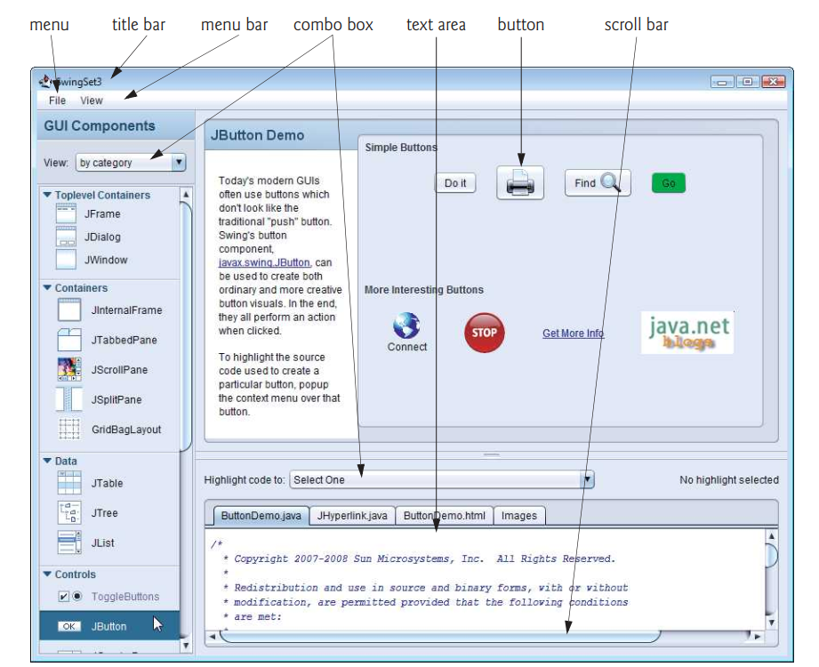
Swing Set
Nimbus: a cross-platform look-and-feel of Swing

Slide 4
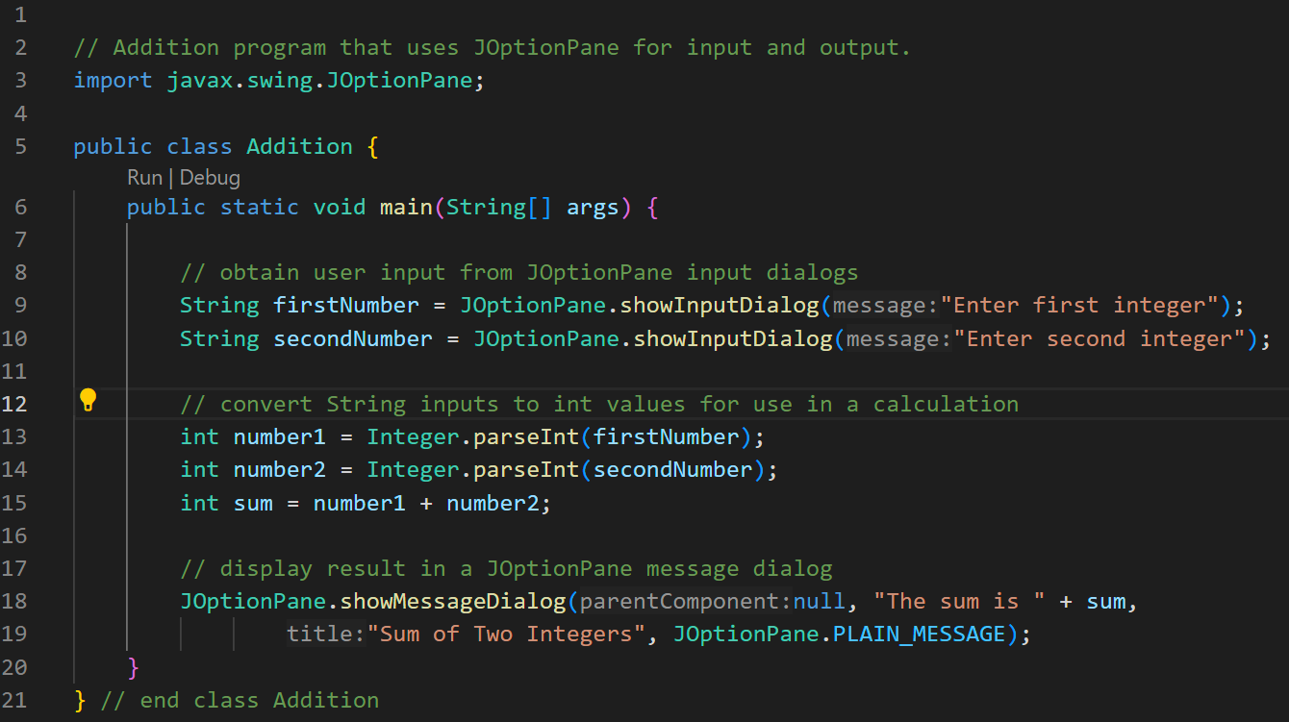

Slide 5
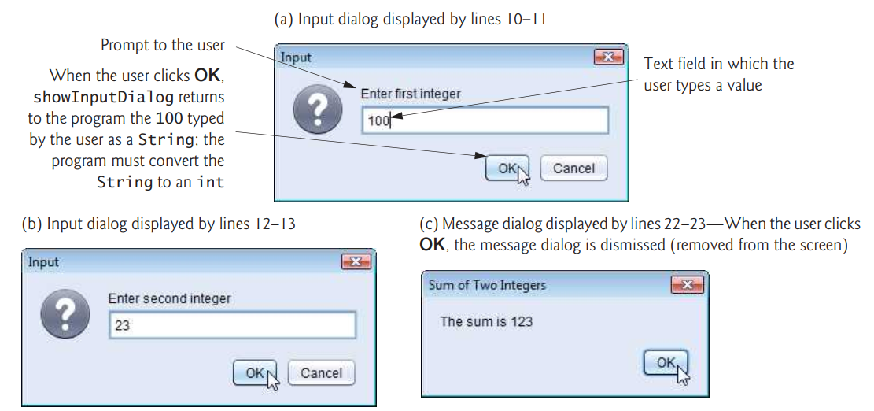

Slide 6
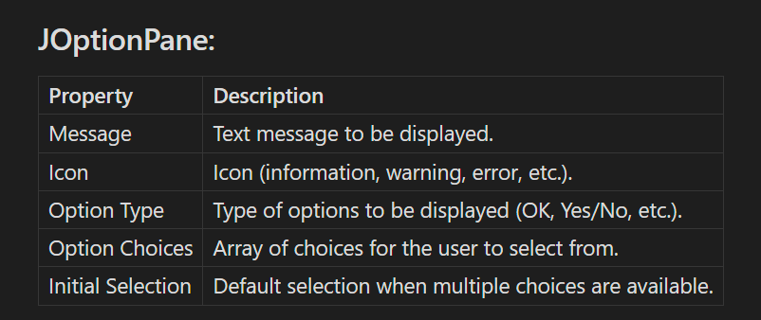

Slide 7
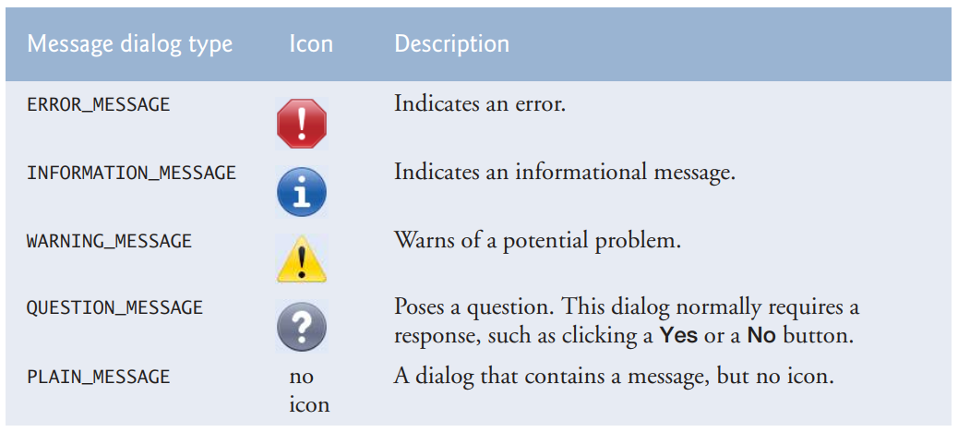
JOptionPane Message Dialog Constants

